Slide 1
8 BIT Arithmetic Logic Unit
VLSI Lab-EC403
Under the supervison of
Dr .Vasantha MH
Presented by
B. Naveen Kumar [20ECE1010]
T. Devisree [20ECE1040]
DEPARTMENT OF ELECTRONICS AND COMMUNICATION ENGINEERING
22 ^{nd} November 2023

Slide 2
What is an Arithmetic-Logic Unit (ALU)?
Main part of a Central Processing Unit .
Carries out arithmetic and logic operations on the Operands in computer .
What is Propagation Delay ?
The average of time taken for output to change from low level to high level and high level to low level.
Tp = (TpHL + TpLH) / 2

Slide 3
How our Idea Started..?
Full Adder
NOT
Adder
8 B
I
T A
L
U
AND
Full Adder
Subtracter
OR
And
Multiplicator
Full Adder
XOR
Increment
Left Shift
MUX
Half Adder
Decrement
Right Shift
MUX
Half Subs

Slide 4
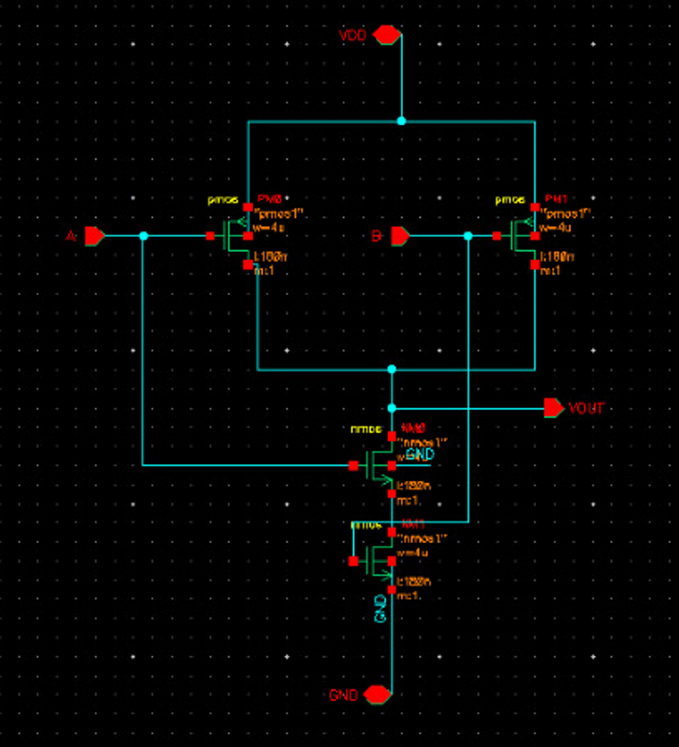
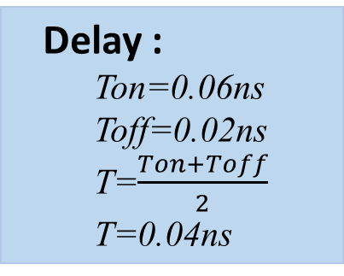
NAND:
Y=(A.B)’
A | B | C
0 | 0 | 1
0 | 1 | 1
1 | 0 | 1
1 | 1 | 0
Delay :
Ton=0.06ns
Toff=0.02ns
T=$\frac{Ton+Toff}{2}$
T=0.04ns
Transistors:
4 mosfets

Slide 5
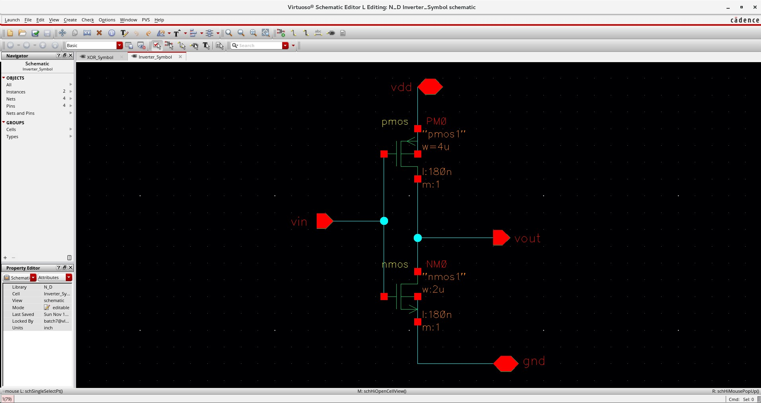
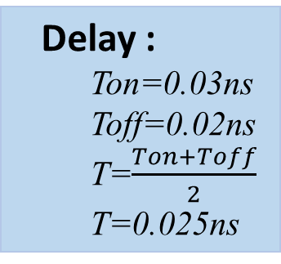
Inverter:
Y=A’
A | Y
0 | 1
1 | 0
Delay :
Ton=0.03ns
Toff=0.02ns
T=$\frac{Ton+Toff}{2}$
T=0.025ns
Transistors:
2 mosfets

Slide 6
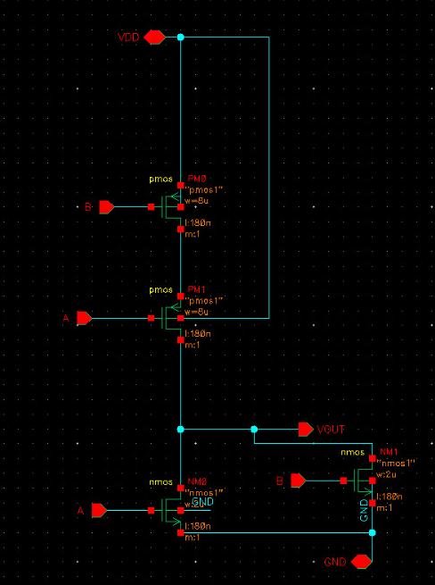
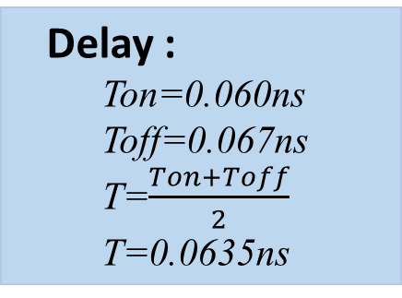
NOR:
Y=(A+B)’
A | B | C
0 | 0 | 1
0 | 1 | 0
1 | 0 | 0
1 | 1 | 0
Delay :
Ton=0.060ns
Toff=0.067ns
T=$\frac{Ton+Toff}{2}$
T=0.0635ns
Transistors:
4 mosfets

Slide 7
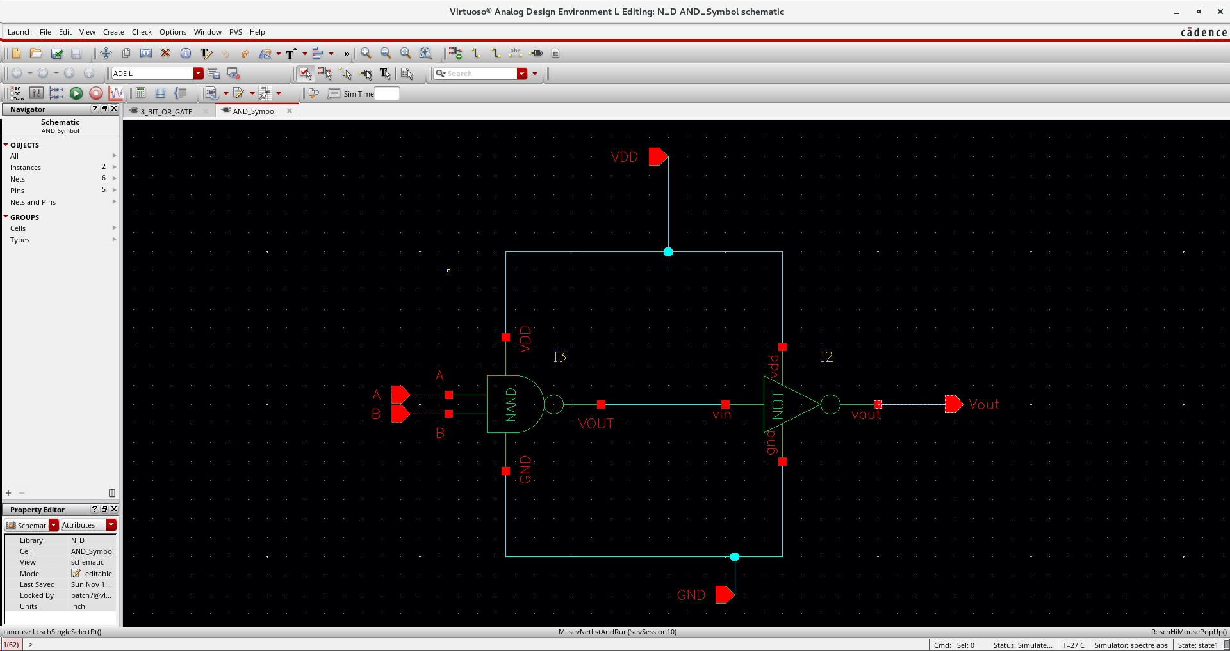
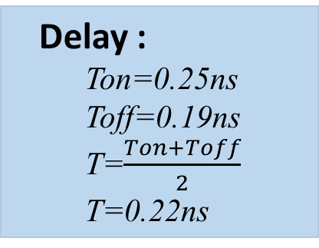
AND:
Y=A.B
A | B | C
0 | 0 | 0
0 | 1 | 0
1 | 0 | 0
1 | 1 | 1
Delay :
Ton=0.25ns
Toff=0.19ns
T=$\frac{Ton+Toff}{2}$
T=0.22ns
Transistors:
6 mosfets

Slide 8
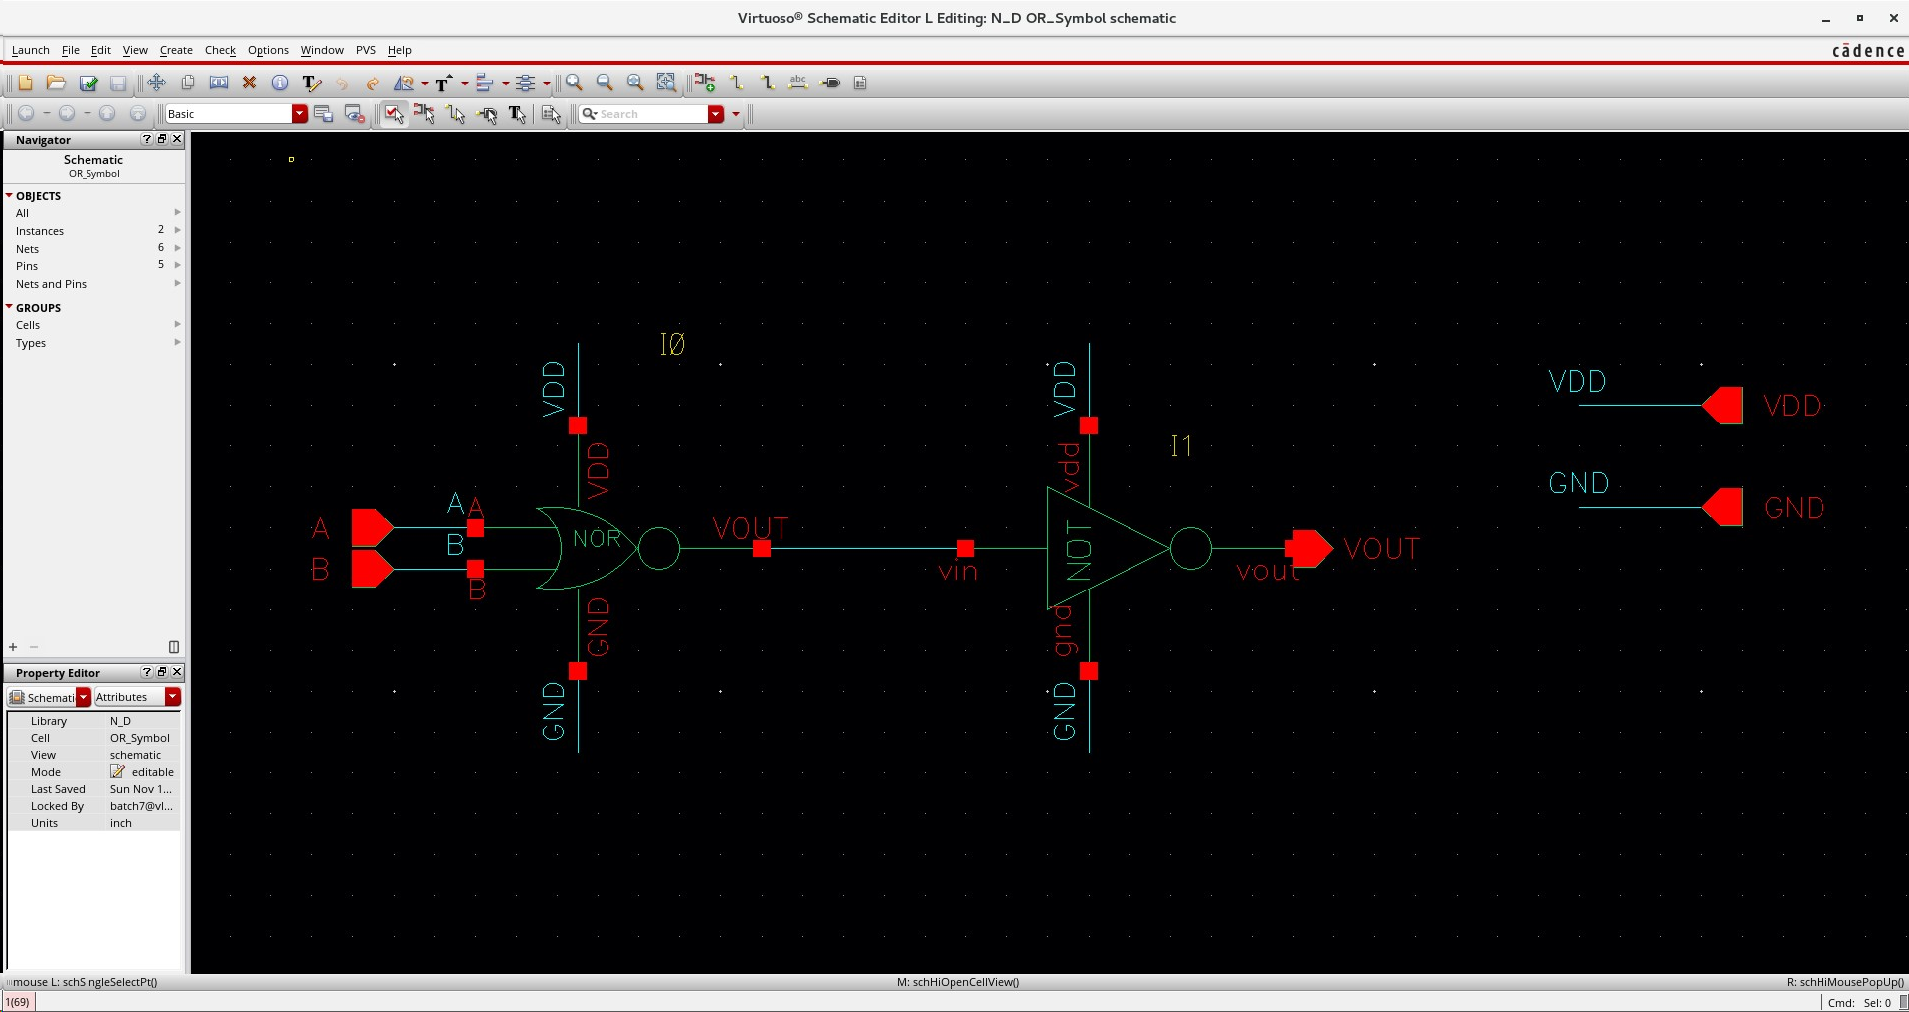
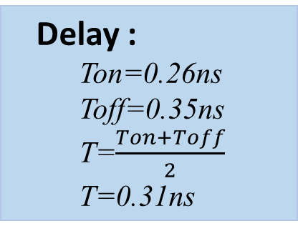
OR:
A | B | C
0 | 0 | 1
0 | 1 | 1
1 | 0 | 1
1 | 1 | 0
Y=A+B
Delay :
Ton=0.26ns
Toff=0.35ns
T=$\frac{Ton+Toff}{2}$
T=0.31ns
Transistors:
6 mosfets

Slide 9
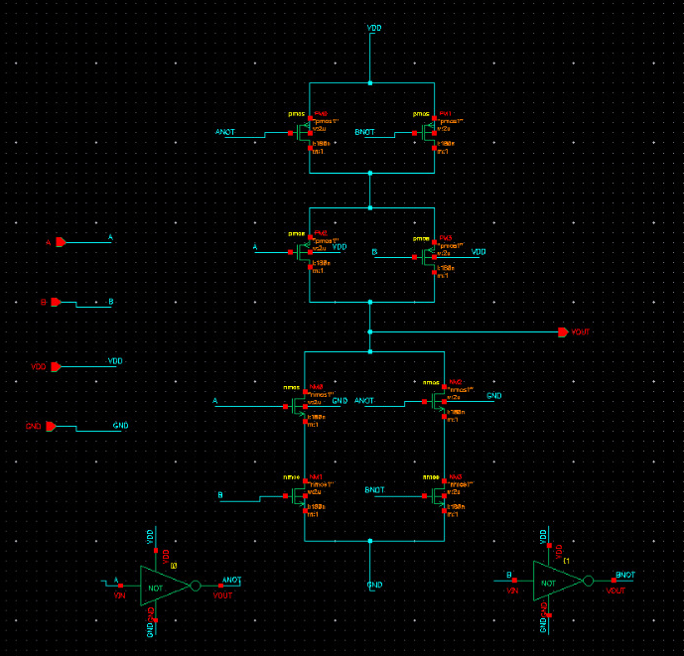
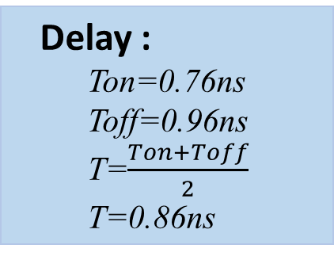
XOR:
Y=A’B + AB’
A | B | C
0 | 0 | 0
0 | 1 | 1
1 | 0 | 1
1 | 1 | 0
Delay :
Ton=0.76ns
Toff=0.96ns
T=$\frac{Ton+Toff}{2}$
T=0.86ns
Transistors:
12 mosfets

Slide 10
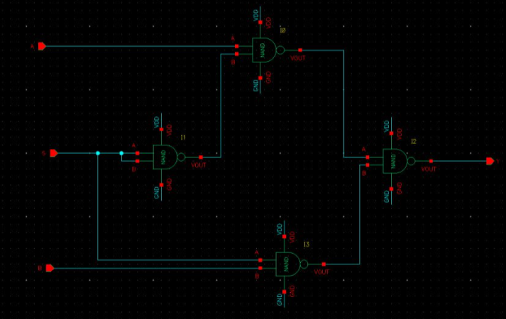
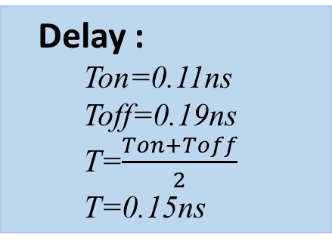
2*1 MUX
Y=AS’ + BS
S | Y
0 | A
1 | B
Delay :
Ton=0.11ns
Toff=0.19ns
T=$\frac{Ton+Toff}{2}$
T=0.15ns
Transistors:
16 mosfets

Slide 11
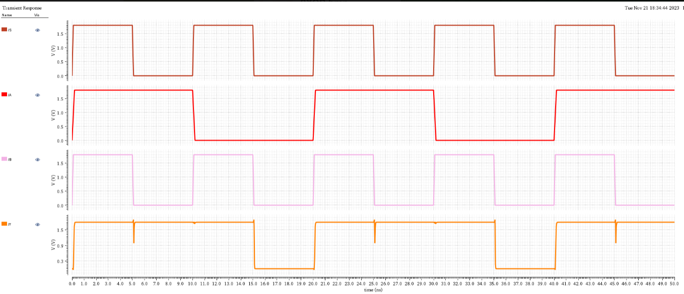
Output For 2*1 MUX:

Slide 12
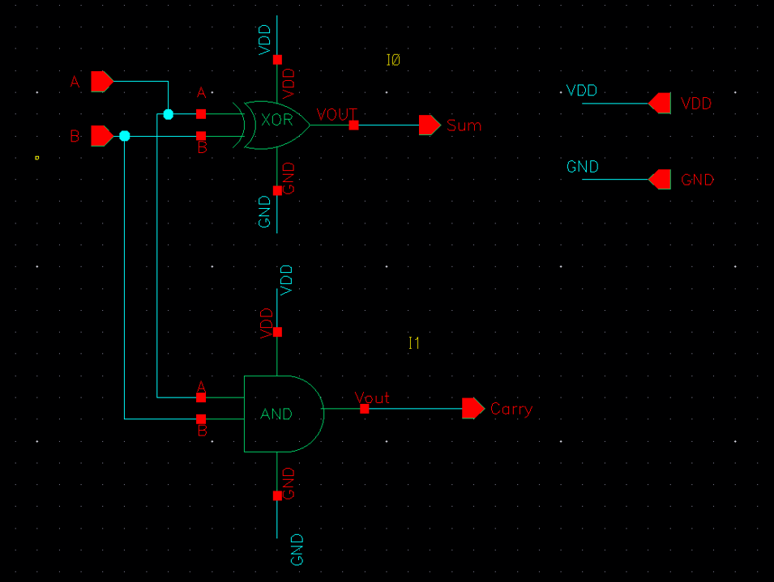
Half-Adder
Sum= A⊕B
Carry= A*B
A | B | Sum | Carry
0 | 0 | 0 | 0
0 | 1 | 1 | 0
1 | 0 | 1 | 0
1 | 1 | 0 | 1
Transistors:
20 mosfets

Slide 13
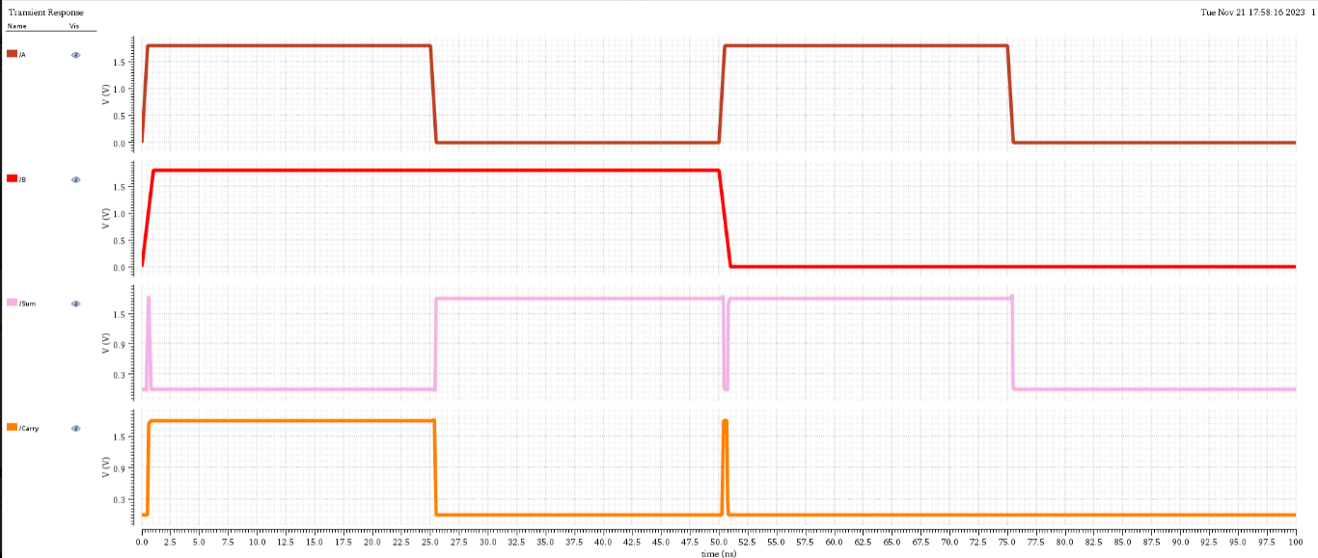

Output For Half- Adder:
Delay :
Sum:
Ton=0.048ns
Toff=0.16ns
T=$\frac{Ton+Toff}{2}$
T=0.104ns
Carry:
Ton=0.179ns
Toff=0.07ns
T=$\frac{Ton+Toff}{2}$
T=0.1245ns

Slide 14
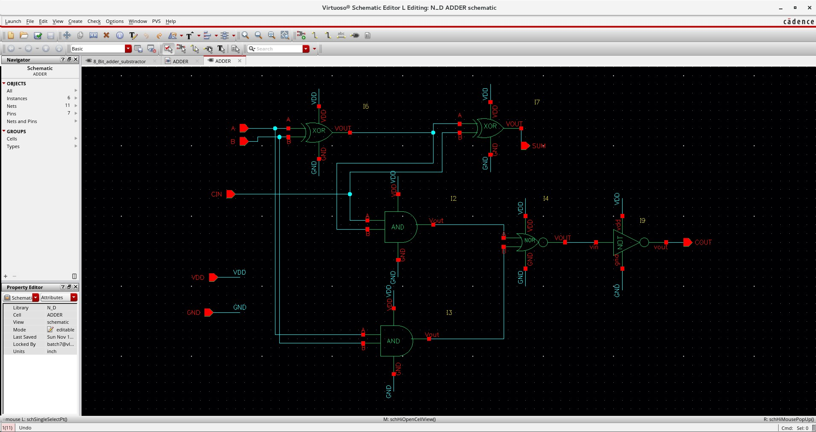
Full Adder
S = A ⊕B⊕Cin;
Cout = (A*B) + (Cin*(A⊕B)).
A | B | C | S | C0
0 | 0 | 0 | 0 | 0
0 | 0 | 1 | 1 | 0
0 | 1 | 0 | 1 | 0
0 | 1 | 1 | 0 | 1
1 | 0 | 0 | 1 | 0
1 | 0 | 1 | 0 | 1
1 | 1 | 0 | 0 | 1
1 | 1 | 1 | 1 | 1
Transistors:
38 mosfets

Slide 15
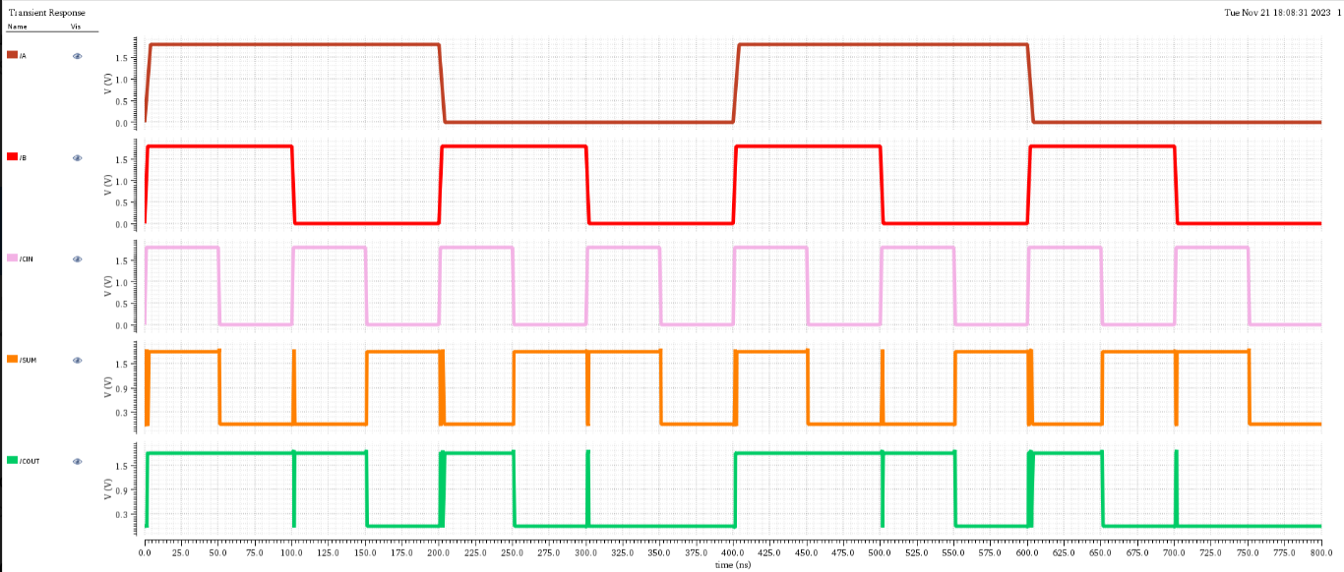

Output For Full Adder:
Delay :
Sum:
Ton=0.72ns
Toff=0.3ns
T=$\frac{Ton+Toff}{2}$
T=0.51ns
Carry:
Ton=0.04ns
Toff=0.1ns
T=$\frac{Ton+Toff}{2}$
T=0.07ns

Slide 16
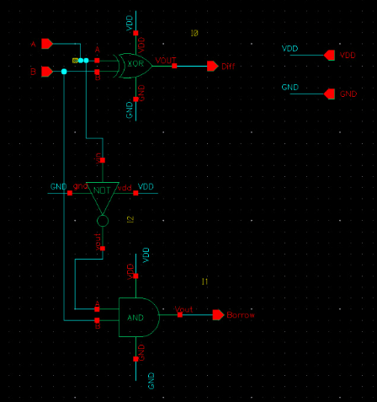
Half subtractor
Diff= A⊕B
Borrow= A’B
A | B | D | B0
0 | 0 | 0 | 0
0 | 1 | 1 | 1
1 | 0 | 1 | 0
1 | 1 | 0 | 0
Transistors:
22mosfets

Slide 17
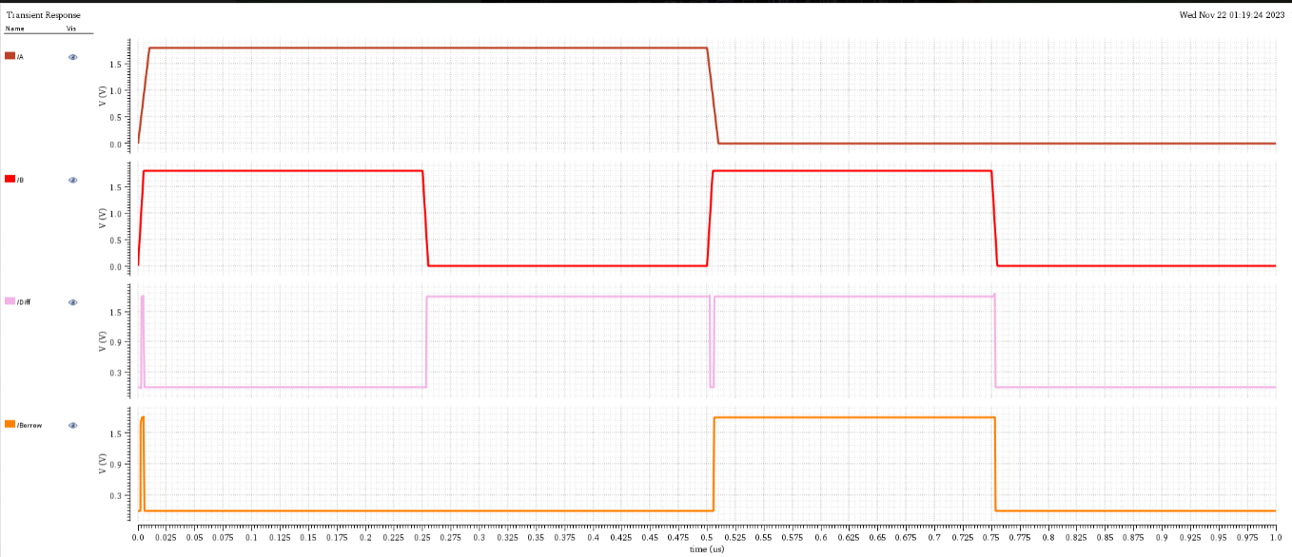

Output For Half Subtractor:
Delay :
Sum:
Ton=0.068ns
Toff=0.08ns
T=$\frac{Ton+Toff}{2}$
T=0.174ns
Carry:
Ton=0.199ns
Toff=0.09ns
T=$\frac{Ton+Toff}{2}$
T=0.1445ns

Slide 18
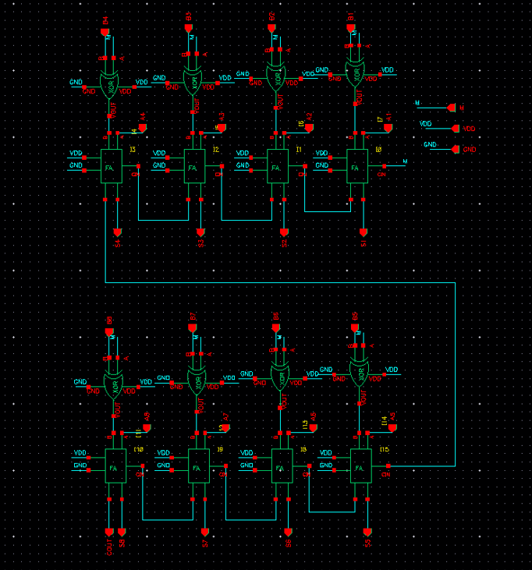
8 Bit Adder and subtractor
Addition:
1
1 0 0 0 0 0 0 1
1 1 0 0 0 1 0 1
1 0 1 0 0 0 1 1 0
Carry
Subtraction:
1 2
1 0 0 0 0 0 0 1
0 1 1 0 0 0 0 1
1 0 0 1 0 0 0 0 0
Borrow

Slide 19
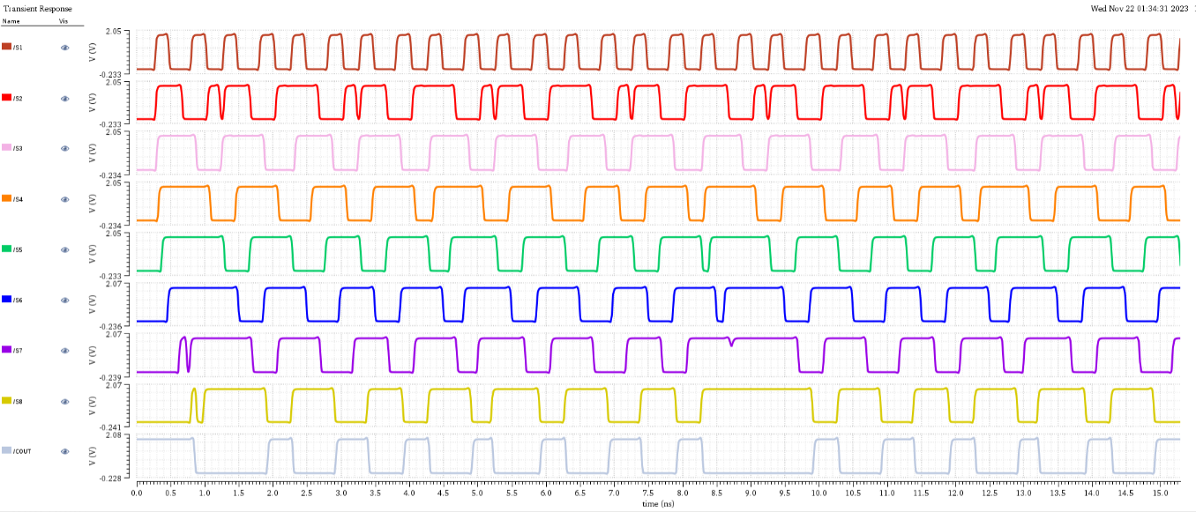
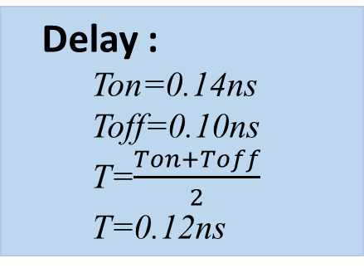
Output For 8 Bit Adder :
Delay :
Ton=0.14ns
Toff=0.10ns
T=$\frac{Ton+Toff}{2}$
T=0.12ns

Slide 20
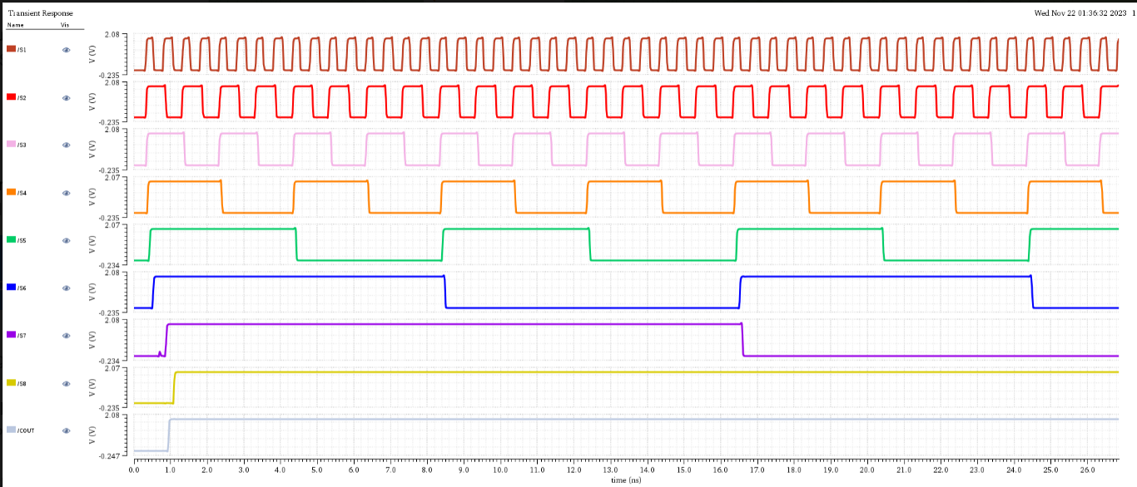
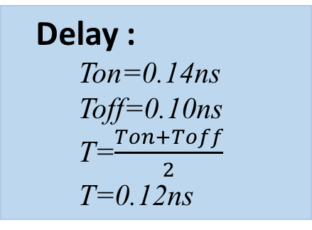
Output For 8 Bit subtractor :
Delay :
Ton=0.14ns
Toff=0.10ns
T=$\frac{Ton+Toff}{2}$
T=0.12ns

Slide 21
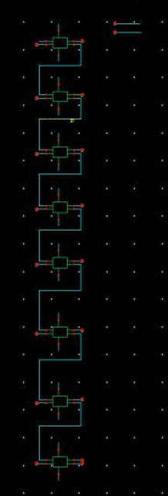
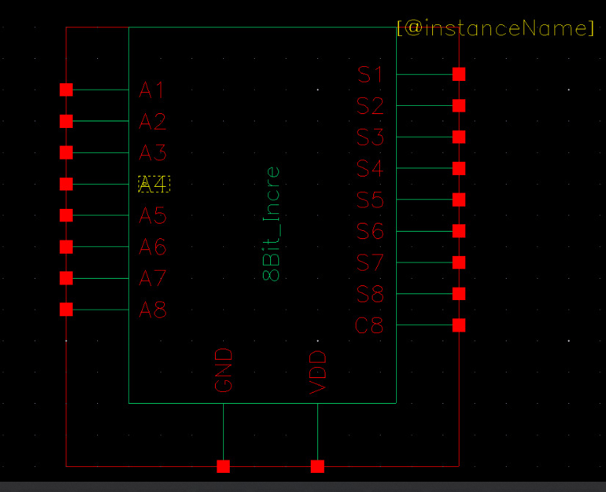
8 Bit Increment
1 0 1 1 0 0 0 1
1
0 1 0 1 1 0 0 1 0
Carry

Slide 22
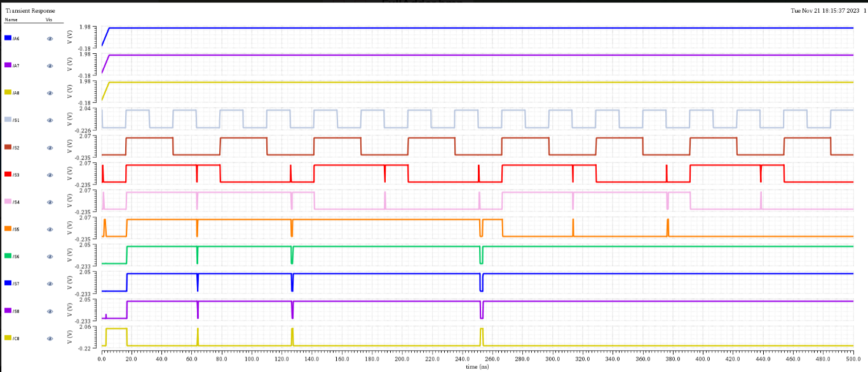

Output For 8 Bit Increment :
Delay :
Ton=0.12ns
Toff=0.410ns
T=$\frac{Ton+Toff}{2}$
T=0.26ns

Slide 23
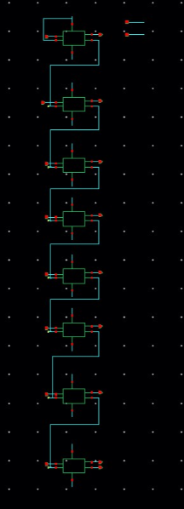
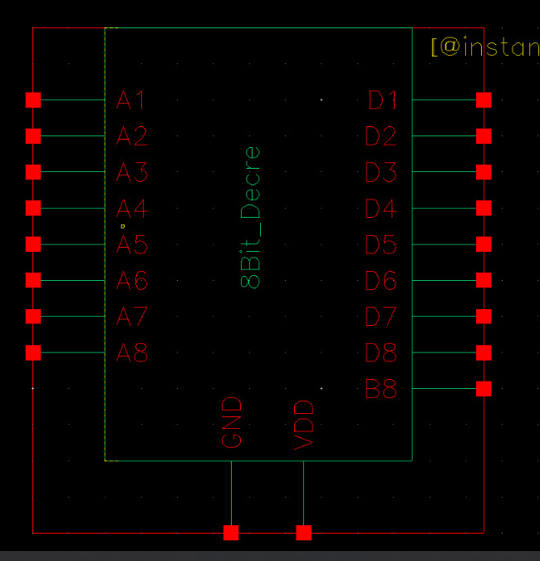
8 Bit Decrement
0 2
1 0 1 1 0 0 1 0
1
0 1 0 1 1 0 0 0 1
Borrow

Slide 24
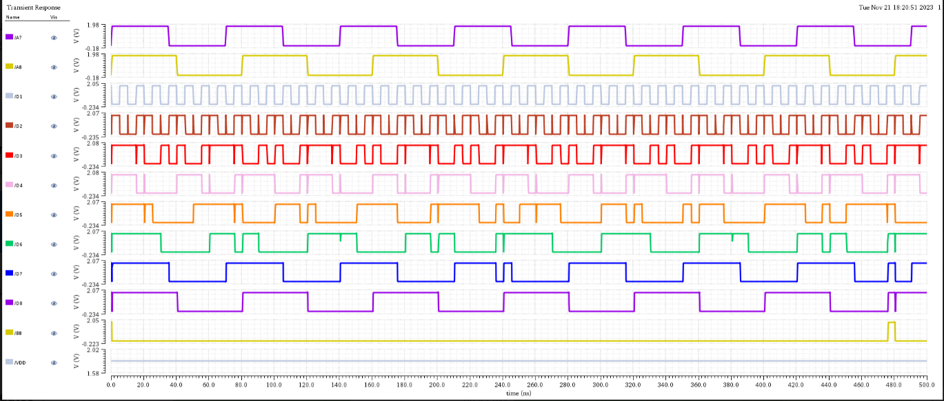
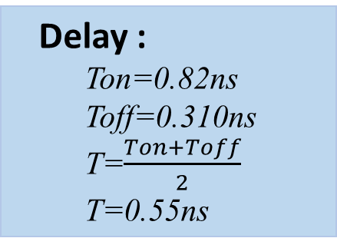
Output For 8 Bit Decrement :
Delay :
Ton=0.82ns
Toff=0.310ns
T=$\frac{Ton+Toff}{2}$
T=0.55ns

Slide 25
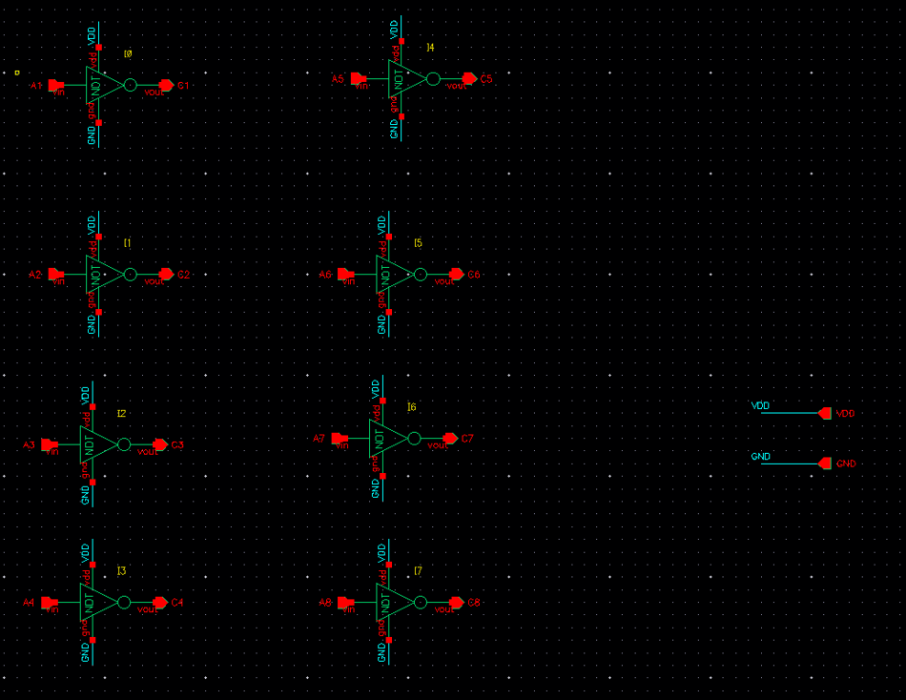
8 Bit NOT
A = 1 0 0 1 1 0 0 1
C= 0 1 1 0 0 1 1 0

Slide 26
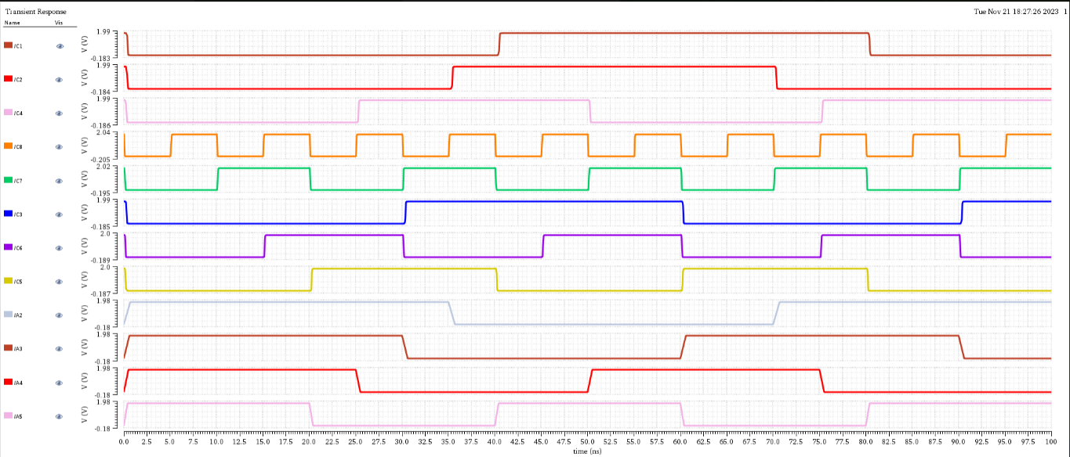
Output For 8 NOT :

Slide 27
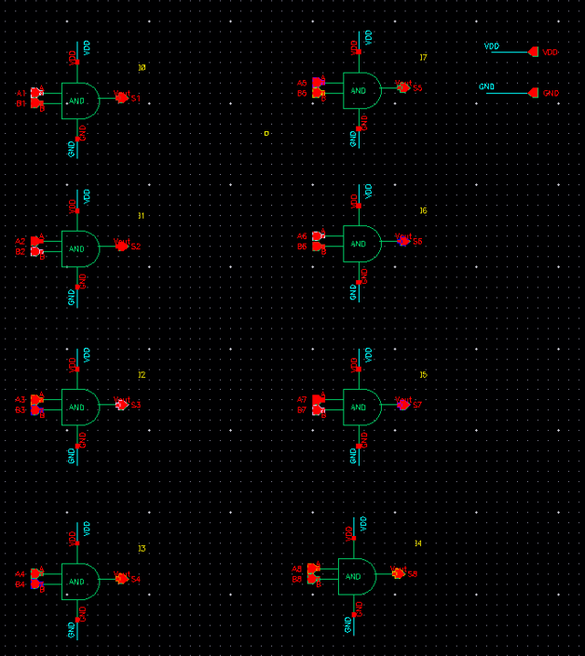
8 Bit AND
A = 1 0 0 1 1 0 0 1
B= 1 1 0 0 1 1 0 0
S= 1 0 0 0 1 0 0 0

Slide 28
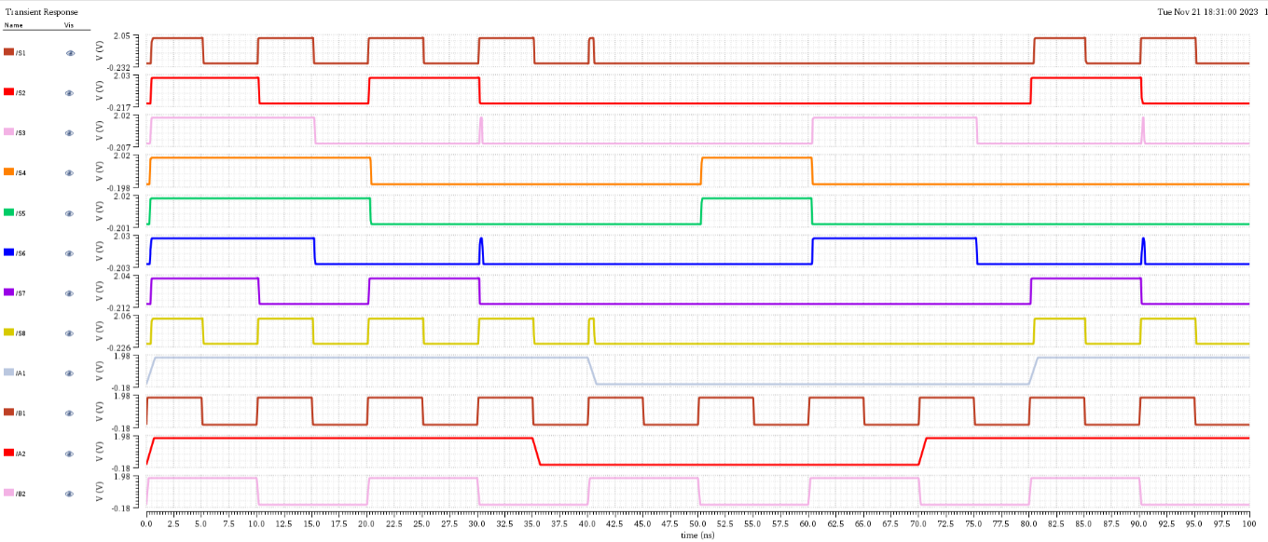
Output For 8 AND :

Slide 29
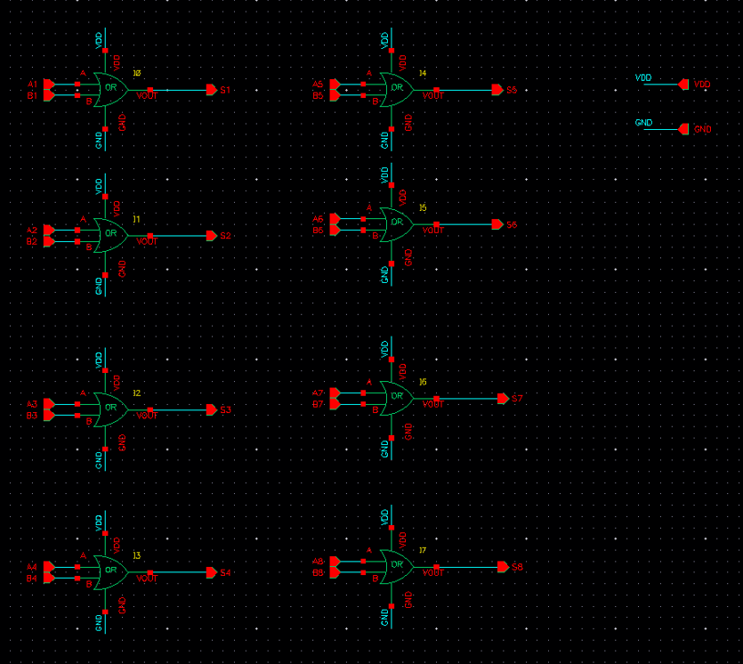
8 Bit OR
A = 1 0 0 1 1 0 0 1
B = 1 1 0 0 1 1 0 0
S = 1 1 0 1 1 1 0 1

Slide 30
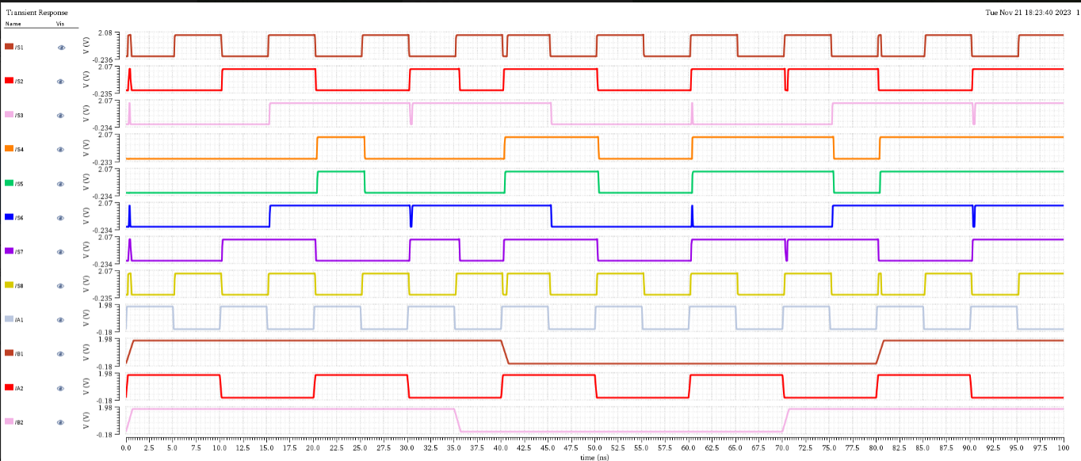
Output For 8 OR :

Slide 31
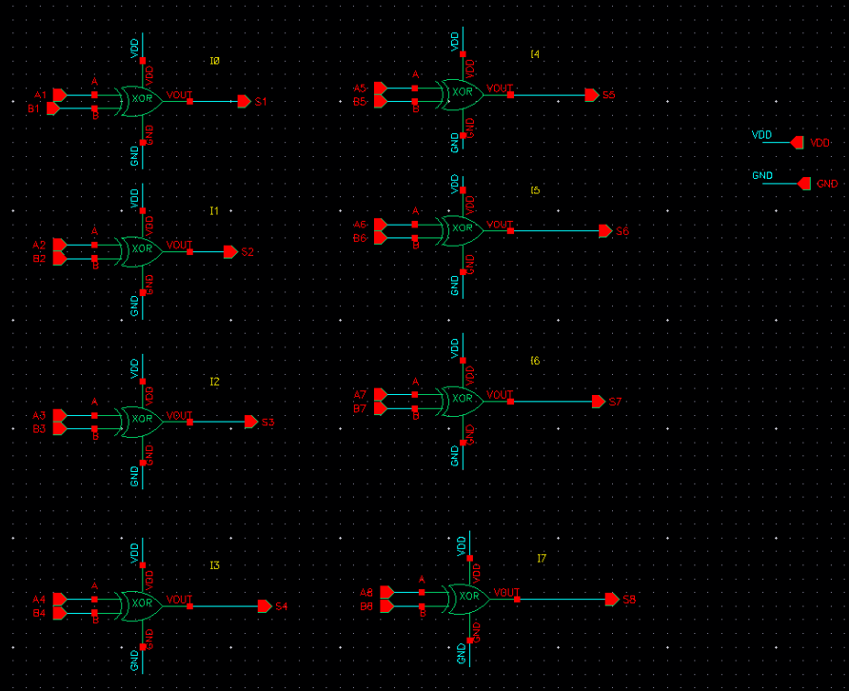
8 Bit XOR
A = 1 0 0 1 1 0 0 1
B= 1 1 0 0 1 1 0 0
S= 0 1 0 1 0 1 0 1

Slide 32
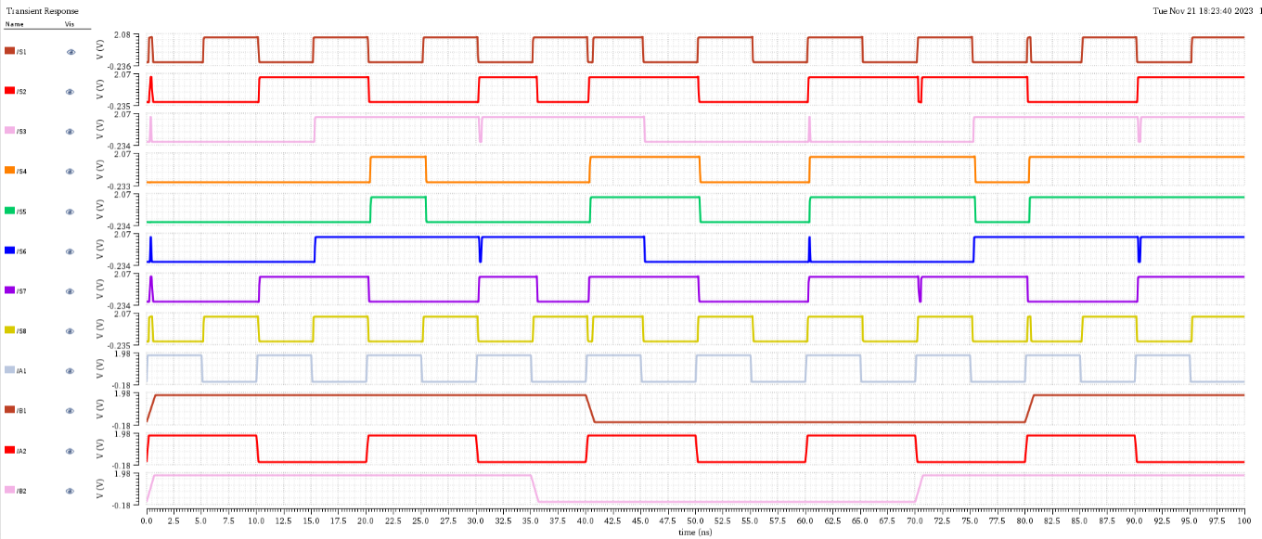
Output For 8 XOR :

Slide 33
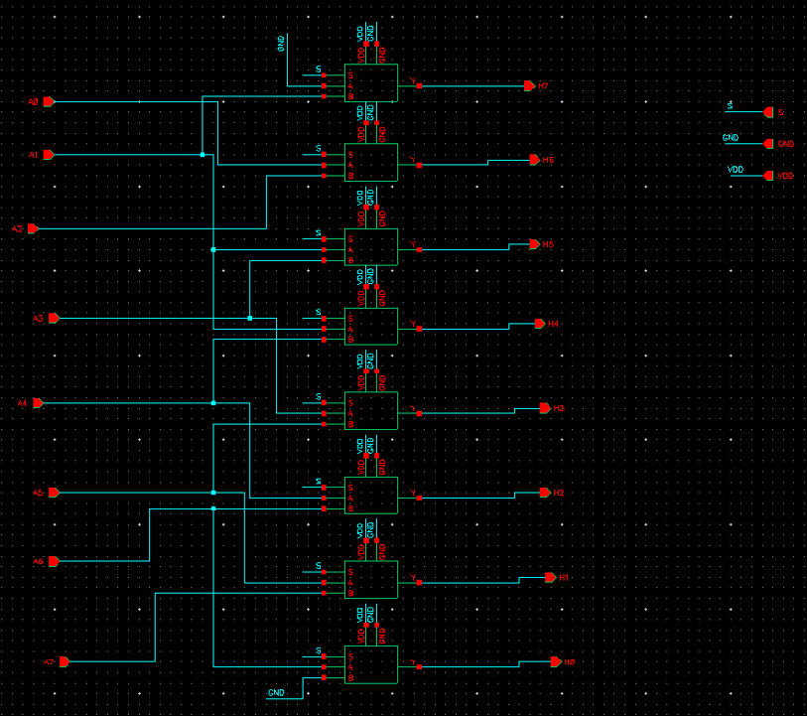
8 Bit Left Shift
A =
0 | 0 | 0 | 1 | 0 | 1 | 0 | 1
S =
0 | 0 | 1 | 0 | 1 | 0 | 1 | 0
0

Slide 34
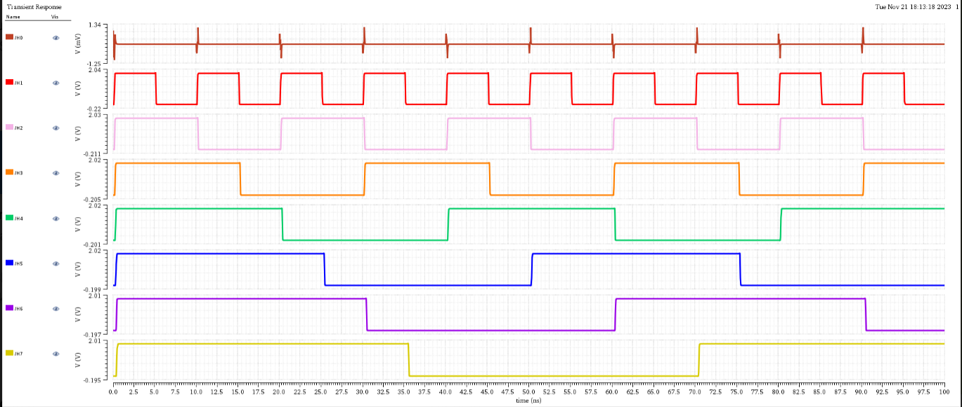
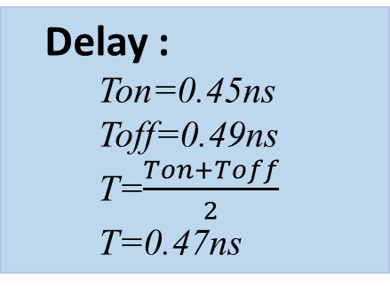
Output For 8 Bit Left Shifter :
Delay :
Ton=0.45ns
Toff=0.49ns
T=$\frac{Ton+Toff}{2}$
T=0.47ns

Slide 35
8 Bit Right Shift
A =
0 | 0 | 0 | 1 | 0 | 1 | 0 | 1
S =
0
0 | 0 | 0 | 0 | 1 | 0 | 1 | 0

Slide 36
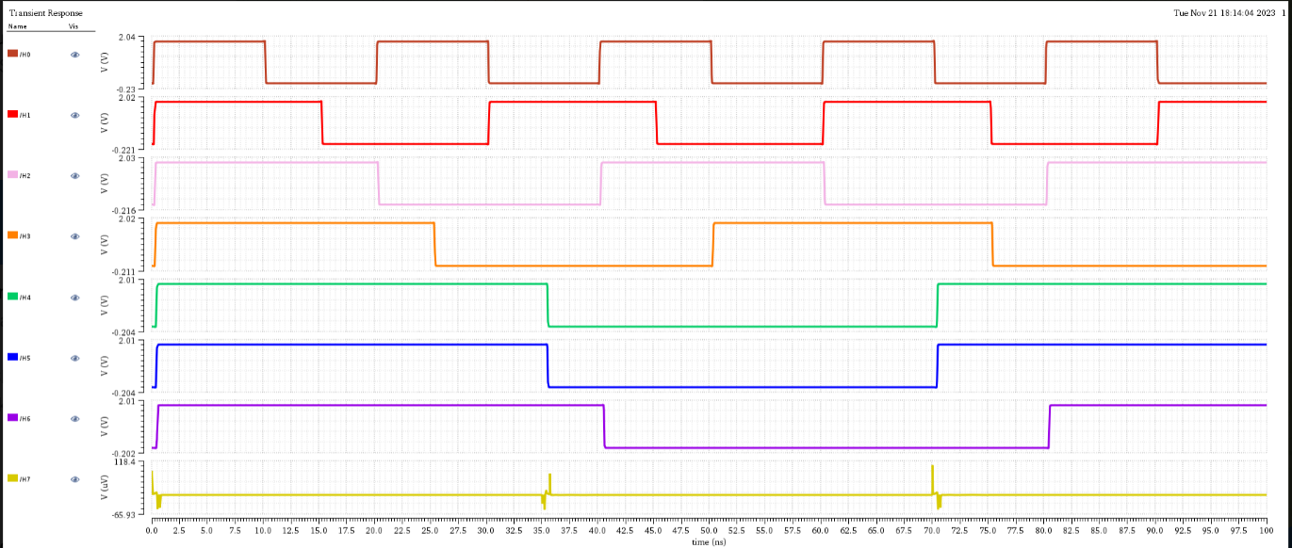
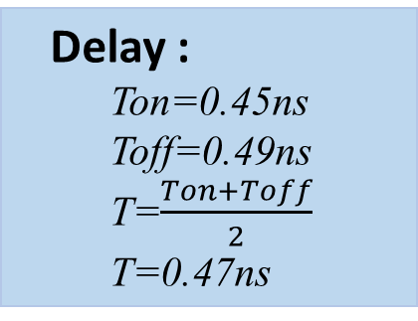
Output For 8 Bit Right Shifter :
Delay :
Ton=0.45ns
Toff=0.49ns
T=$\frac{Ton+Toff}{2}$
T=0.47ns

Slide 37
8 Bit Multiplication Algorithm
b7 b6 b5 b4 b3 b2 b1 b0
a7 a6 a5 a4 a3 a2 a1 a0
a0b7 a0b6 a0b5 a0b4 a0b3 a0b2 a0b1 a0b0
a1b7 a1b6 a1b5 a1b4 a1b3 a1b2 a1b1 a1bo
a2b7 a2b6 a2b5 a2b4 a2b3 a2b2 a2b1 a2b0 c0
a3b7 a3b6 a3b5 a3b4 a3b3 a3b2 a3b1 a3b0 c1
A4b7 a4b6 a4b5 a4b4 a4b3 a4b2 a4b1 a4b0 c2
a5b7 a5b6 a5b5 a5b4 a5b3 a5b2 a5b1 a5b0 c3
a6b7 a6b6 a6b5 a6b4 a6b3 a6b2 a6b1 a6b0 c4
a7b7 a7b6 a7b5 a7b4 a7b3 a7b2 a7b1 a7b0 c5
c14 c13 c12 c11 c10 c9 c8 c7 c6
S15 S14 S13 S12 S11 S10 S9 S8 S7 S6 S5 S4 S3 S2 S1 S0

Slide 38
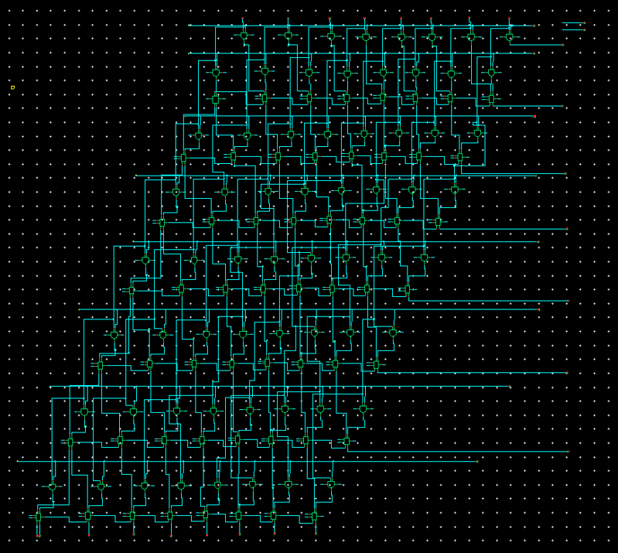
8 Bit Multiplication
A = 1 0 0 1 1 0 0 1
B= 1 1 0 0 1 1 0 0
S= 1 1 1 1 0 0 1 1 1 1 1 0 1 1 0 0

Slide 39

Output For 8 Bit Multiplier :

Slide 40

16*1 MUX:

Slide 41


Output For 16*1 MUX:
Delay :
Ton=1.2ns
Toff=0.07ns
T=$\frac{Ton+Toff}{2}$
T=0.635ns

Slide 42

8 Bit Arithmetic Logic Unit:
S3 | S2 | S1 | S0 | Output
0 | 0 | 0 | 0 | Addition
0 | 0 | 0 | 1 | Subtraction
0 | 0 | 1 | 0 | Increment
0 | 0 | 1 | 1 | Decrement
0 | 1 | 0 | 0 | NOT
0 | 1 | 0 | 1 | AND
0 | 1 | 1 | 0 | OR
0 | 1 | 1 | 1 | XOR
1 | 0 | 0 | 0 | Left Shift
1 | 0 | 0 | 1 | Right Shift
1 | 0 | 1 | 0 | Multiplication

Slide 43

8 Bit ALU :

Slide 44
Thank You….!

